Slide 1
Biological Relationships

Slide 2
“Microbial Devices” are genetic devices that control the interactions between the organism and its environment, be that soil, a cell, a plant, an animal
This week we specifically focus on interactions with other organisms
Why is this important?
Don’t make pathogens!
The competition between pathogens and hosts has resulted in many useful parts
Must understand this if you want to develop biological therapeutics

Slide 3
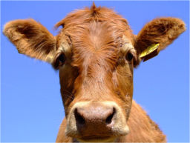
Classical Relationship Terminology
Symbiosis – prolonged relationships between two organisms
Mutualism – symbiosis in which both species benefit
Vibrio fisheri and Hawaiian bobtail squid
Algae in lichens
Bifidobacterium sp. in a human intestinal tract
Commensalism – one species benefits, the other is largely unaffected
E. coli K12 in a human intestinal tract
Parasitism – one species benefits, the other is harmed
Plasmodium sp. in blood (malaria)
Pathogenesis – like parasitism, but isn’t necessarily a prolonged relationship
E. coli O157:H7 (EHEC) in a human intestinal tract
This is not a modern reductionist view of biology

Slide 4



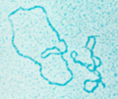
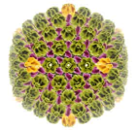

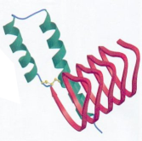
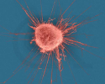

Microbial diversity
Transposons
Bacteria
Multicellular Eukaryoties (worms, insects)
Plasmids
Viruses
Eukaryotic Single Cells (Protozoa)
Prions
Mammalian Cells (cancer)
Bacteriophages

Slide 5
Minimal cellular relationships
An interacting organism
A Compartment (an organ, a cell, a test tube, a rock, etc.)

Slide 6
Minimal cellular relationships
Physical Association
Barrier Penetration

Slide 7
Minimal cellular relationships
Growth
SCHNOPs
Energy source
Iron, Magnesium, Calcium, Potassium, Sodium
Other trace elements
Many biological compartments have all these things

Slide 8

Minimal cellular relationships
organelle
nutrients
cell
organ
Only cellular compartments MUST have primary metabolites and ions, but there always is a cell, so the nutrients are always present, but they may be inaccessible from some biological compartments

Slide 9
Then evolution interfered…
First defense: iron sequestration
Almost all biological compartments sequester iron, both to protect themselves from other biologicals, but also to protect themselves from iron/oxygen chemistry
Intracellularly, iron is bound to proteins (enzymes or storage molecules like ferritan) or small molecule siderophores (such as heme)
In extracellular compartments, iron is either absent altogether or tied up in storage proteins such as transferrin (blood) or lactoferrin (milk)
Many (if not most) microbes have evolved mechanisms of scavenging iron from sequestered sources
Process is called “high-affinity iron transport”

Slide 10
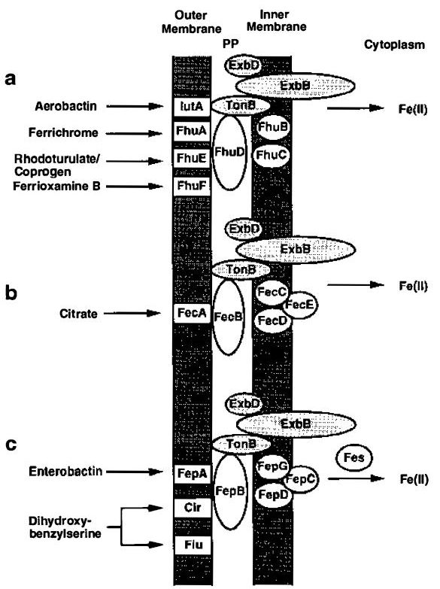
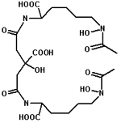
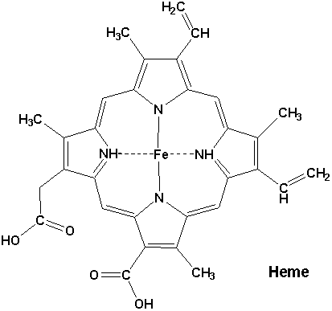
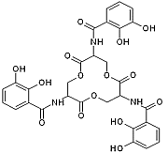
High-Affinity Iron Transport
Low Affinity transporters:
ZupT
MntH
FeoABC
Aerobactin
Heme
Enterobactin

Slide 11
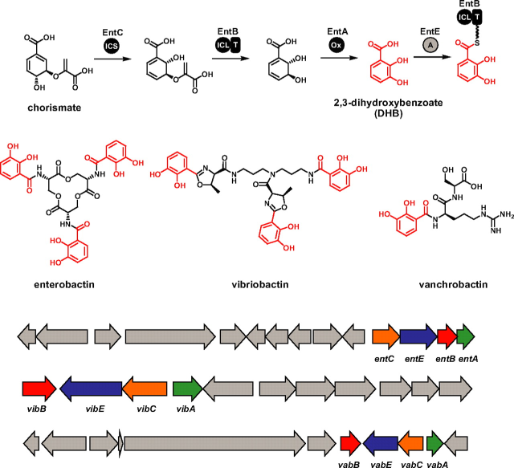
Genetics of iron transport

Slide 12
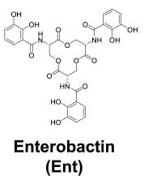
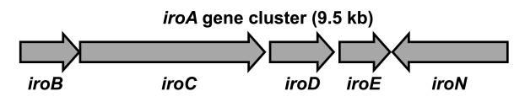
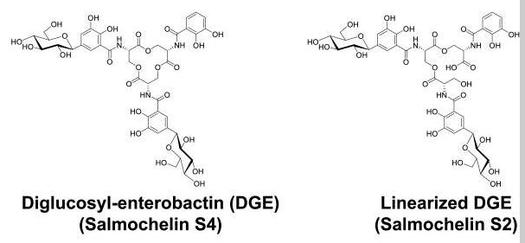
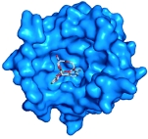
Evading high-affinity iron transport
Lipocalin 2 (Lcn)
PMID: 17060628
Notes:
Pretty much all coli’s/salmonella/shigellas make enterobactin, and in vitro that is suffient to draw the iron out of transferrin (blood carrier of iron). However, most mammalian immune systems have evolved Lcn which sequesters Ent. It’s stored in neutrophil granules and released upon TLR4 activation. In response, some Salmonella enterica strains (and various other enterobacterial isolates including Colis and Klebsiellas) have evolved iroA which transfers glucoses onto enterbactin, restoring virulence.

Slide 13
Second defense: physical barriers
All cells minimally have a lipid bilayer protecting them from other biological agents
Many also contain a wall (peptidoglycan and outer membrane for gram negative, S-layer for gram positive, other walls for plant cells, yeasts, and protozoa)
Some microbes can actively penetrate these barriers
Multicellular organisms may include specialized compartments (organs) covered in additional protective layers—think epithelial cells
Can have specialized organs that prevent access to more susceptible organs – think skin, the physical coating of a human being that presents a thick proteinaceous layer that is difficult to penetrate, or think exoskeleton, a carbohydrate barrier on insects
Very few modern unicellular agents are able to penetrate epithelial, skin, or exoskeletal barriers
Penetrance of organs usually requires an alternate route, often requires physical disruption of the organ barrier
Multicellular organisms can produce such physical disruptions

Slide 14

The Human Body
Mouth, Nose, Ears, Eye socket
Nutrients
Skin
Cells
Epithelial Layers
Liver
Stomach
Lungs
Intestines
Kidneys (renal pelvis regions)
Bladder
Blood
Brain
Lymph
Anus, Urethra, Vagina

Slide 15
Commensal and Symbiotic Microbes
Mouth, Nose, Ears, Eye socket
Liver
Stomach
Lungs
Intestines
Kidneys (renal pelvis regions)
Bladder
Blood
Brain
Lymph
Anus, Urethra, Vagina

Slide 16
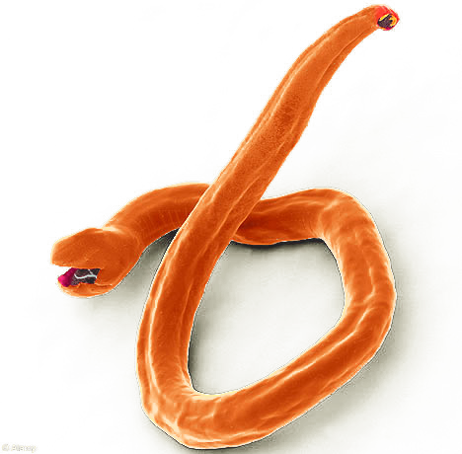
Getting past the barriers
Stomach, lungs, and intestines are readily accessible by eating, drinking, and breathing
Areas such as kidneys and bladder don’t present a physical barrier to infection, but are active in removing invading biologicals
Other areas of the body require an active barrier-evasion mechanism
Multicellular parasites sometimes burrow right through the skin
Most unicellular parasites can’t do things like that

Slide 17
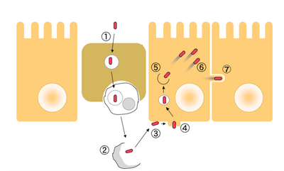
Shigella penetration of epithelium
Epithelial lining of intestines
M Cell

Slide 18
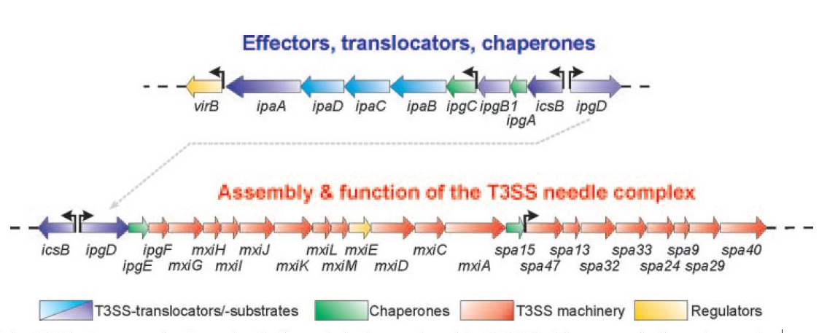
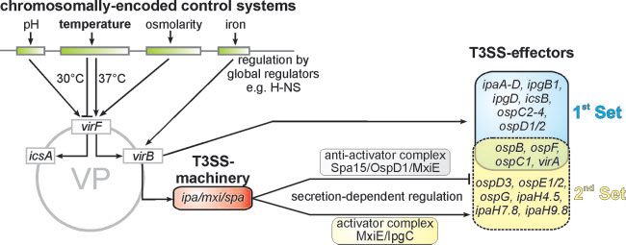
Genetics of Shigella invasion
PMID 18202440

Slide 19
Fourth defense: phagocytosis
Macrophages and neutrophils search for and “eat” debris on the size scale of viruses and bacteria
Neutrophils are first responders but have low capacity
Monocytes in blood become macrophages upon extravasition in areas of inflammation
Get populations of macrophages that reside in specific tissues such as epithelial layers
The large liver population called the Kupffer macrophages, are responsible for filtering any bacteria out of the bloodstream (amongst other things)
Bacteria have evolved strategies of evading phagocytosis (will get to those in a moment)

Slide 20
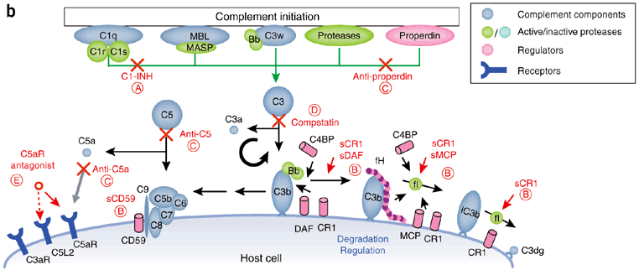
Fifth defense: complement system
A protein fraction of the blood somewhat like the blood clotting cascade
Very old, even invertebrates can have a complement system
The complement system can actively destroy bloodborne pathogens by depositing itself on surface and punching holes
Can use antibodies as adapter molecules, but also has its own lectins that bind to a variety of bacterial surfaces
Can facilitate phagocytosis

Slide 21
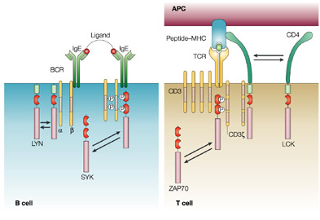
Sixth defense: adaptive immunity
Previous infections can trigger the formation of antibodies and T-cell receptors
B cells each produce a single type of antibody that targets a specific antigen
T cells each produce a single T-cell receptor that binds to cell-displayed peptides attached to MHC complexes
Process of tagging an agent for complement-mediated lysis or phagocytosis is called opsonization

Slide 22
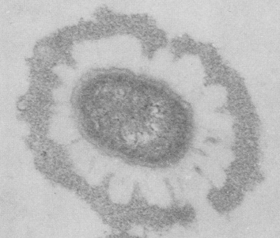
Evading opsonization
Almost all commensal and pathogenic bacteria display capsular polysaccharides to avoid opsonization by antibodies or lectins
O-antigens are polymeric repeats of an oligosaccharide attached to lipopolysaccharide on the cell surface
K capsules are usually homopolymeric polysaccharides anchored in the outer membrane
Some bacteria secrete proteins that bind to and inactivate complement components or antibodies (ex: protein A)
Some bacteria secrete proteases to cleave antibodies
Some induce formation of blood clots to shield themselves in the bloodstream
(Non-Fimbrial Adhesin)
K-Capsule/LPS
O-Antigen
Periplasm

Slide 23
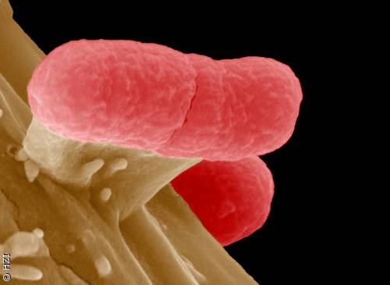
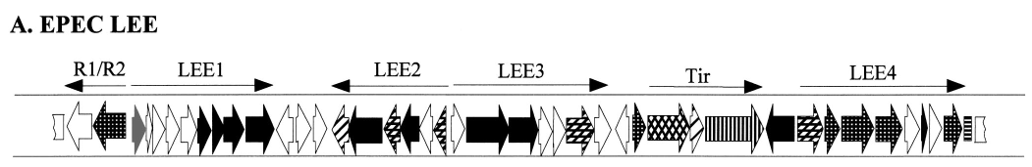
Additional tricks
Quorum sensing: cell-cell signaling
Biofilm formation (Ex: Pseudomonas aeruginosa)
Residing within vacuoles of macrophages
Residing in epithelial cells
Resistance to acidity of the stomach
Toxins to induce diarrhea or bleeding
Secreting outer membrane vesicles
Advanced adherence mechanisms: formation of adhering and effacing lesions by EHEC and EPEC (40kb for LEE alone and 20kb for the bundle forming pilus)

